Slide 1
Aim: How many ways can you greet a person in Spanish?
Do Now: Copy vocabulary -> Translate the ones you know
1. Buenos días 11. ¿Cómo estás?
2. Buenas noches 12. ¿Y tú? / ¿Y usted (Ud.)?
3. Buenas tardes 13. (muy) bien
4. Hola 14. regular
5. ¿Cómo te llamas? 15. mal
6. Me llamo 16. gracias
7. Encantado/a 17. Adiós
8. Igualmente 18. Hasta luego
9. Mucho gusto 19. Hasta mañana
10. ¿Cómo está Ud.? 20. Nos vemos
HOMEWORK#2 – BRING CONTRACT SIGNED and STUDY VOCAB
PRACTICE!

Slide 2
Tú vs. Usted
Read top of page 5
Would you say tú or Usted when talking to the following people?
Your brother
Your teacher
Your best friend
Your friend’s mother
Your principal
Your doctor
A new acquaintance who is your age

Slide 3
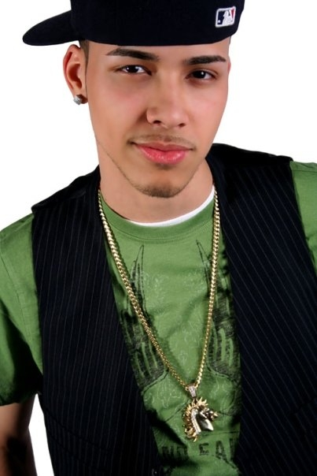
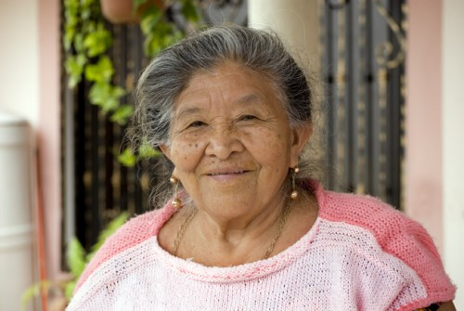
How would you greet these people?
Greet then ask how they are doing.
2.
1.
3.

Slide 4
Page 5 Activity #4
¿Hola o Adiós? As you hear each greeting or leaving taking place, place a check mark in the appropriate column.
Greeting | Leaving
1.
2.
3.
4.
5.
6.
7.
8.
✓
✓
✓
✓
✓
✓
✓
✓

